Slide 1
Undiagnosed-1: Clinical Genetic Testing
Ed Esplin, MD, Phd, facmg, facp
Clinical geneticist

Slide 2
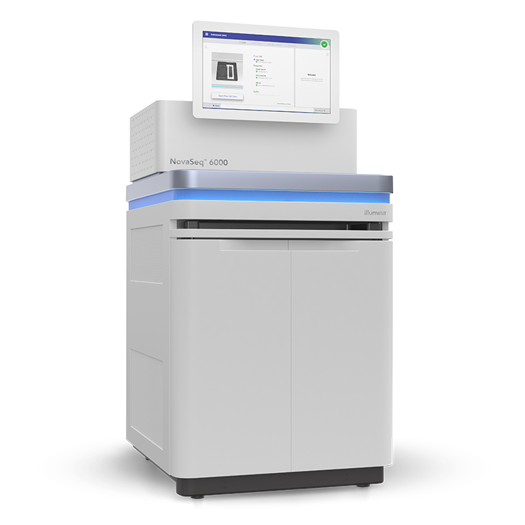
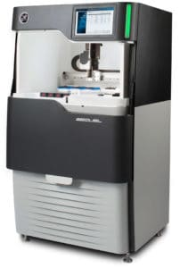
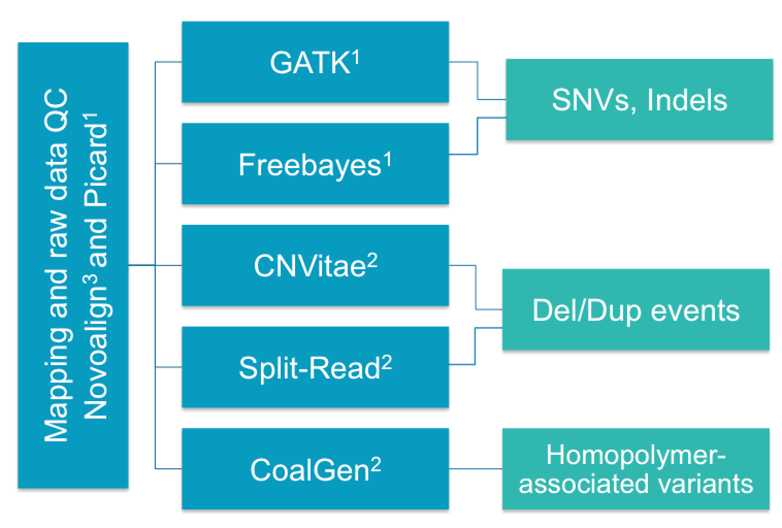
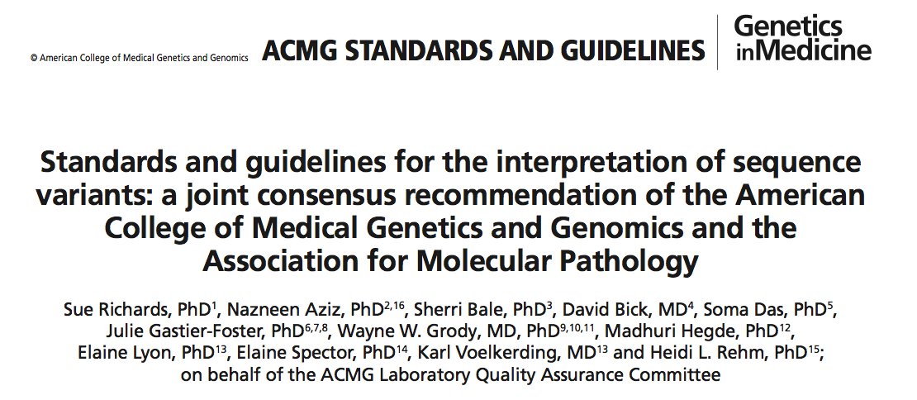
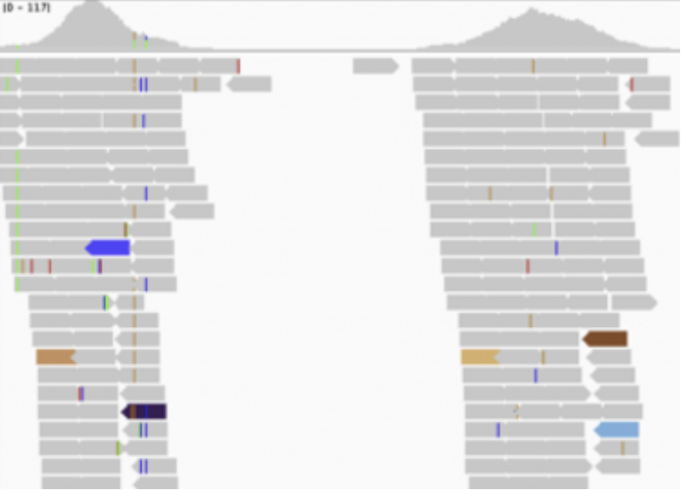



Scalable advanced technology and automation
Standards-based processes with Invitae improvements
Standard clinical processes
DNA extraction and QC
GENE
TARGETING
NEXT-GENERATION
SEQUENCING
BIOINFORMATICS
VARIANT
CLASSIFICATION
VALIDATION
GATK Haplotype Mapper
HIGH & EVEN COVERAGE
350–400x
Average
Richards et al., Genet Med 2015
Nykamp et al., Genet Med. 2017 Oct;19(10):1105-1117.
Advanced customized bioinformatics
Lincoln et al., J Mol Diag 2015
© 2019 Invitae Corporation. All Rights Reserved. | CONFIDENTIAL
Notes:
After we receive a patient sample, DNA is extracted and assessed for quality and quantity. With our highly automated system, ~1600 samples can be processed and analyzed every 8 hours with limited human intervention. This includes DNA library preparation and next-generation sequencing primarily on Illumina sequencing machines. This is followed by bioinformatic analysis…

Slide 3
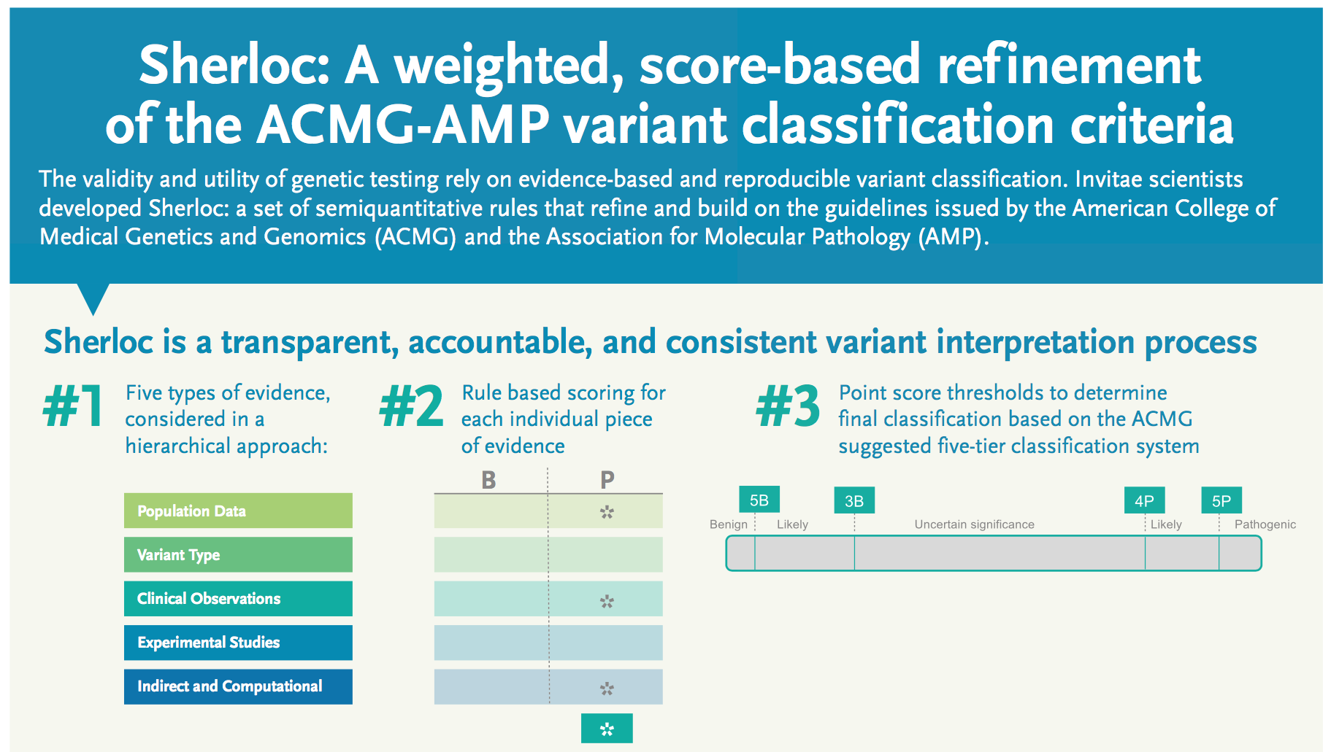


Slide 4
Rigorous variant interpretation and reporting
Linear process of variant interpretation involving scientists, genetic counselors, and laboratory directors
Rigorous application of Sherloc to ensure transparency and consistency
Performed in an auditable custom-built software platform
Genetic counselors
Licensed lab directors
Variant scientists
Medical geneticists
Senior scientists
Variant interpretation
Report write-up
Quality check
Sign out
Research
Exhaustive searches of the literature and databases.
Critical evaluation
Are published assertions convincing?
Evidence structuring
How does this evidence contribute to an argument?
Synthesis and classification
Does all the evidence combined meet our threshold?
Write-up
Summarize evidence and logic in a clear way.
QC
Check, then check again.

Slide 5
Clinical Testing strategy
Patient’s clinical history
30 year old male with history of gastroesophageal reflux, gastroparesis, emesis, failure to thrive, low body weight, visceral hypersensitivity, fatigue, low IgG, leukopenia, elevated urine lactate.
Family history of paternal half-sister with hereditary fructose intolerance

Slide 6
Diagnostic genetic testing
Multigene panels
Metabolic gene panel (577 genes)
Cardiovascular/Neuromuscular panel (323 genes)
Carrier panel (301 genes)
Rare disease panel (526 genes)
1727 genes
Exome, boosted
data on… ~20,000 genes
phenotype-based candidate list of… 3783 genes

Slide 7
Previous findings confirmed…
ALDOB (AR)
Pathogenic/VUS
TTN (AD/AR)
Likely Pathogenic
GYG1 (AR)
Likely Pathogenic
 | Fructose Disorder
 | Hereditary Fructose Intolerance
Deficiency | Aldolase B
Symptoms | Hypoglycemia Hepatomegaly Jaundice Vomiting
Treatment | Avoid Sucrose & Fructose
Dilated cardiomyopathy
Glycogen storage disorder – accumulation in liver, muscle, heart

Slide 8
Additional “findings” to explore?...
Variants of Uncertain Significance
NFIX – AD Sotos syndrome
TTC21B – AR nephronophthisis
WDR19 – AR asphyxiating thoracic dystrophy
EXOSC3 – AR pontocerebellar hypoplasia
RYR2 – AD CPVT
SGCB – AR limb-girdle muscular dystrophy
Other data, analyses…
AMPD1 – MMDD disorder
IL17RC - ???
LRBA – AR LRBA deficiency
RMRP – CHH-AD disorder
TH – tyrosine hydroxylase deficiency
UNC93B1 – HSV encephalitis
VPS13B – AR Cohen syndrome

Slide 9
Final analysis
Does it fit the Patient?

